Slide 1
Transmission Media

Slide 2
Transmission Media
In a data transmission system, the transmission medium is the physical path between transmitter and receiver.
It can be classified into 2 classes:
  Guided medium
    Electromagnetic waves are guided along a solid medium, such as copper twisted pair ,copper coaxial cable and optical fiber
  Unguided media
    Wireless transmission occurs through the atmosphere, outer space, or water.

Slide 3
Transmission Media
The quality of a data transmission are determined, both by the characteristics of the medium and the characteristics of the signal.
  For guided media, the medium itself is more important in determining the limitations of transmission.
  For unguided media, the bandwidth of the signal produced by the transmitting antenna is more important than the medium in determining transmission characteristics.
    One key property of signals transmitted by antenna is directionality.
    Low frequency signals are omnidirectional, i.e. the signal propagates in all directions from the antenna.
    At higher frequencies ,it is possible to focus the signal into a directional beam.
    Key concerns in data transmission system design are data rate and distance: the greater the data rate and distance, the better.

Slide 4
Transmission Media
The design factors relating to the transmission medium and the signal that determine the data rate and distance are:
  Bandwidth
    The greater the bandwidth of a signal ,the higher the data rate that can be achieved ,with all other factors remaining constant.
  Transmission impairments
    Impairments like attenuation limit the distance.
    For guided media,twisted pair generally suffers more impairment than coaxial cable which in turns suffer more than optical fiber.

Slide 5
Transmission Media
  Interference
    Interference from competing signals in overlapping frequency bands can distort or wipe out a signal.
    In guided media, it is caused by nearby cables.
    Proper shielding may avoid this problem
    Interference can be experienced in unguided media also
  Number of receivers
    Guided medium can be used to construct a point-to-point link or shared link with multiple attachments
    In shared link, each attachment introduces some attenuation and distortion on the line limiting distance and /or data rate

Slide 6
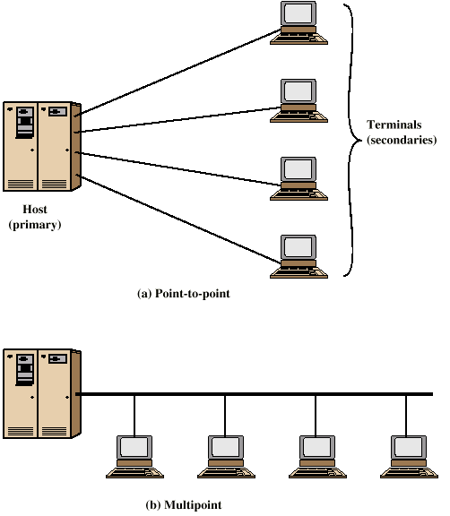
Traditional Configurations

Slide 7
Electromagnetic Spectrum
The fig. shows the electromagnetic spectrum and indicates the frequencies at which various guided and unguided transmission techniques operate

Slide 8
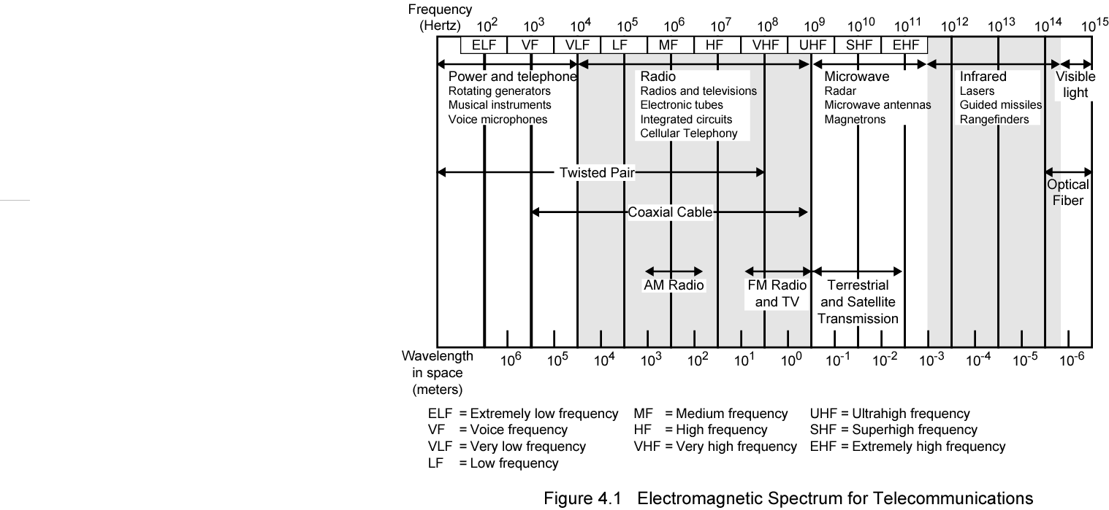
Electromagnetic Spectrum

Slide 9
Guided Transmission Media
For guided transmission media ,the transmission capacity is measured in terms of data rate or bandwidth which depends on distance and on whether the medium is point-to-point or multipoint.
The three guided transmission media commonly used for data transmission are:
    Twisted Pair
    Coaxial cable
    Optical fiber

Slide 10
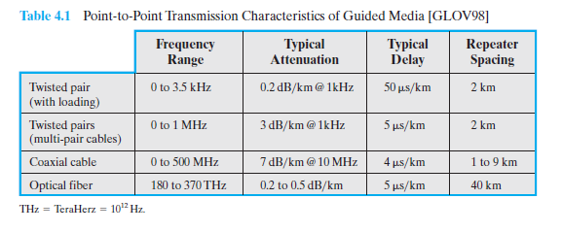
Guided Transmission Media
Table 4.1 indicates the characeteristics typical for the guided media for long distance point-to-point applications

Slide 11
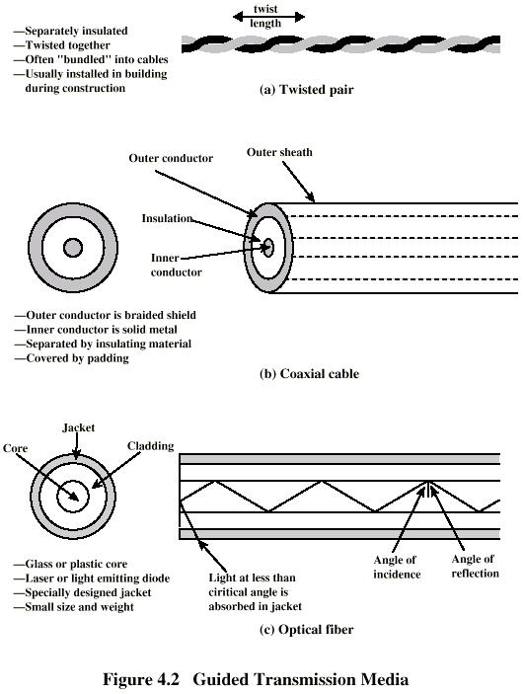
Twisted Pair

Slide 12
Twisted Pair
Least expensive and most widely used guided transmission medium.
A twisted pair consists of two insulated copper wires arranged in a regular spiral pattern
A wire pair acts as a single communication link.
Typically, a number of these pairs are bundled together into a cable by wrapping them in a tough protective shieth.
Over long distances ,cable may contain hundreds of pairs.
The twisting tends to decrease the crosstalk interference between adjacent pairs in a cable, which usually contain hundreds of pairs.

Slide 13
Twisted Pair
The neighboring pairs in a bundle have different twist length to reduce cross talk interference
On long distance links, the twist length typically varies from 5 to 15cm.
The wires in a pair have a thickness of 0.4 to 0.9mm

Slide 14
Twisted Pair - Applications
Most common medium for both analog and digital signals
Telephone network
  Individual residential telephone sets are connected to the local telephone exchange (or “end office”) by twisted-pair wire. These are referred to as subscriber loop.
Within an office building
  Each telephone is connected to a twisted pair, which goes to the in-house private branch exchange (PBX) system.
These twisted-pair installations were designed to support voice traffic using analog signaling.

Slide 15
Twisted Pair - Applications
However, by means of a modem, these facilities can handle digital data traffic at modest data rates.
Twisted pairs are used in local area networks (LAN) for supporting personal computers.
  Data rates can be around 100Mbps, or even 10Gbps.
  For long distance applications ,twisted pair can be used at data rates of 4Mbps or more.
  But for high data rates ,limited number of devices and distance is only supported.

Slide 16
Twisted Pair - Pros and Cons
Pros
  Twisted pair is much less expensive than other commonly used guided transmission media.
  Can be used for both analog and digital transmission
  For analog transmission amplifiers are required at every 5 to 6 km
  For digital transmission repeaters are required at every 2 to 3 km
  Twisted pair is easier to work with.

Slide 17
Twisted Pair - Pros and Cons
Cons:
  limited in distance, bandwidth, and data rate
  Short range: not good for long-distance
  E.g., the data rate of ADSL depends on the distance
    1.5Mbps for 18,000ft
    2.0Mbps for 16,000ft
    6.0Mbps for 12,000ft
    9.0Mbps for 9000ft

Slide 18
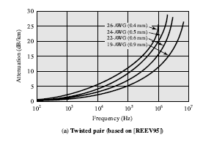
Attenuation of Twisted Pair
Attenuation for twisted pair is a very strong function of frequency
Other impairments also severe for twisted pair

Slide 19
Unshielded and Shielded TP
Twisted pair comes in two varieties:
  Unshielded Twisted Pair (UTP)
  Shielded Twisted Pair
Unshielded Twisted Pair (UTP)
  Ordinary telephone wire
  Cheapest
  Easiest to install and work with
  Suffers from external electromagnetic interference

Slide 20
Unshielded and Shielded TP
UTP categories
  EIA-568(Electronic Industries Association): Commercial Building Telecommunications Cabling Standard recognizes three categories of UTP cabling.
  Category 3(Cat 3)
    The transmission characteristics are specified up to 16MHz
      E.g., the attenuation at 16MHz is about 13db per 100m
    Voice grade found in most offices
    Twist length: 7.5 cm to 10 cm
  Category 4(Cat 4)
    Upto 20MHz

Slide 21
Unshielded and Shielded TP
  Category 5
    The transmission characteristics are specified up to 100MHz
      E.g., the attenuation at 16MHz is about 8db per 100m, the attenuation at 100MHz is about 22db per 100m
    Commonly pre-installed in new office buildings
    Twist length: 0.6 cm to 0.85 cm
  Remark: Category 3 & Category 5 cables are widely used in LAN.

Slide 22
Unshielded and Shielded TP
Other categories
  Category 6(Cat6)
    Upto 200MHz
  Category 7(Cat7)
    Upto 600MHz
  Enhanced Category 5(Cat5E)
    Upto 100MHz
Shielded Twisted Pair (STP)
  Shielded by a metal braid or sheathing that reduces interference
  More expensive
  Harder to handle (thick, heavy)

Slide 23
Coaxial Cable
i

Slide 24
Coaxial Cable
Consists of two conductors: outer conductor & inner conductor
A hollow outer cylindrical conductor that surrounds a single inner wire conductor
The inner conductor is held in place by either regularly spaced insulated rings or a solid dielectric material
The outer conductor is covered with a jacket or shield
A single coaxial cable has a diameter of from 1 to 2.5cm
Coaxial cable can be used over long distances and support more stations on a shared line than twisted pair

Slide 25
Coaxial Cable
Applications
  Television distribution
    Cable TV
      Can carry hundreds of TV channels upto a few tens of kilometers
  Long distance telephone transmission
    Can carry 10,000 voice calls simultaneously(using FDM)
    Being replaced by fiber optic
  Local area networks
  Short-range connections between devices such as high-speed I/O channels on computer

Slide 26
Coaxial Cable
Transmission Characteristics
  Can be used to transmit both analog and digital signals
  Frequency characteristics superior to twisted pair
  Hence used effectively at higher frequencies and data rates
  Analog signal
    Amplifiers every few km
    Closer if higher frequency
    Usable spectrum for analog signaling extends to about 500MHz (about 4MHz for each TV channel)
  Digital signal
    Repeater every 1km
    Closer for higher data rates

Slide 27
Coaxial Cable
Pros
  Effectively used at higher frequencies and data rates
  Because of its shielded ,concentric construction ,coaxial cable is less susceptible to interference and cross talk than twisted pair.
Cons
  Cause attenuation, thermal noise and intermodulation noise

Slide 28
Optical Fiber
An optical fiber is a thin (2 to 125µm),flexible medium which is capable of guiding an optical ray.
Various glasses and plastics are used to make optical fibres.
The lowest loses have been obtained using fibres of ultrapure fused silica.
Ultrapure fiber is difficult to manufacture.
Multi-component glass fibers have higher loss but it is more economical and still provide good performance
Plastic fibers is less costly and can be used for short haul links, for which moderately high losses are acceptable.

Slide 29
Optical Fiber

Slide 30
Optical Fiber
An optical fiber has a cylindrical shape and consists of three concentric sections:
    The core
    The cladding
    The jacket
The core is the innermost section and consists of one or more very thin strands of fibers ,made of glass or plastic.
The core has a diameter in the range of 8 to 50 µm
Each fiber is surrounded by its own cladding ,a glass or plastic coating that has optical properties different from those of the core and a diameter of 125 µm

Slide 31
Optical Fiber
The interface between the core and the cladding acts as a reflector to confine light that would otherwise escape the core.
The outermost layer ,surrounding one or a bundle of cladded fibers ,is the jacket.
The jacket is composed of plastic and other material layered to protect against moisture ,abrasion, crushing and other environmental dangers.

Slide 32
Optical Fiber - Advantages
  Greater capacity
    Potential Bandwidth and hence data rate
    Available bandwidth: about 50THz,
    Data rates of hundreds of Gbps over tens of kilometer is possible (for coaxial cable it is about hundreds of Mbps over about 1km and for twisted pair it is just 100 Mbps to 10Gbps over few tens of meters)
  Smaller size & light weight
    Optical fibers are thinner than coaxial cable or bundled twisted-pair cable
    The small size makes it advantages for using it in cramped conduits in buildings and underground along public right-of-way.
    The reduction in weight reduces structural support requirements

Slide 33
Optical Fiber - Advantages
  Lower attenuation
    Attenuation is significantly lower for optical fiber than for coaxial cable or twisted pair and is constant over a wide range.
  Electromagnetic isolation
    Optical fiber systems are not affected by external electromagnetic fields.
    Thus the system is not vulnerable interference, impulse noise or cross talk.
    Fibers do not radiate energy ,so there is little interference with other equipment and there is a high degree of security from overlapping.
    Fibers are inherently difficult to tap.

Slide 34
Optical Fiber - Advantages
  Greater repeater (or amplifier) spacing
    Few repeaters mean lower cost and fewer sources of error
    For optical fibers ,repeater spacing in the tens of kilometer is common
    Repeater spacing of hundreds of kilometers have also been demonstrated
    For coaxial cable and twisted pair systems generally have repeaters every few kilometers

Slide 35
Optical Fiber - Applications
Optical fiber is used in long distance telecommunication and in military applications
It is of less price and have high performance.
Five basic categories of applications are:
  Long-haul trunks
    thousands of km(average about 1500km)
  Metropolitan trunks
    tens of km(average length about 12km)
  Rural exchange trunks
    hundreds of km(40 to 160km)
  Subscriber loops
    To replace twisted pair and coaxial cable
  Local Area Networks(LANs): very high data rate, 100Mbps to 10Gbps

Slide 36
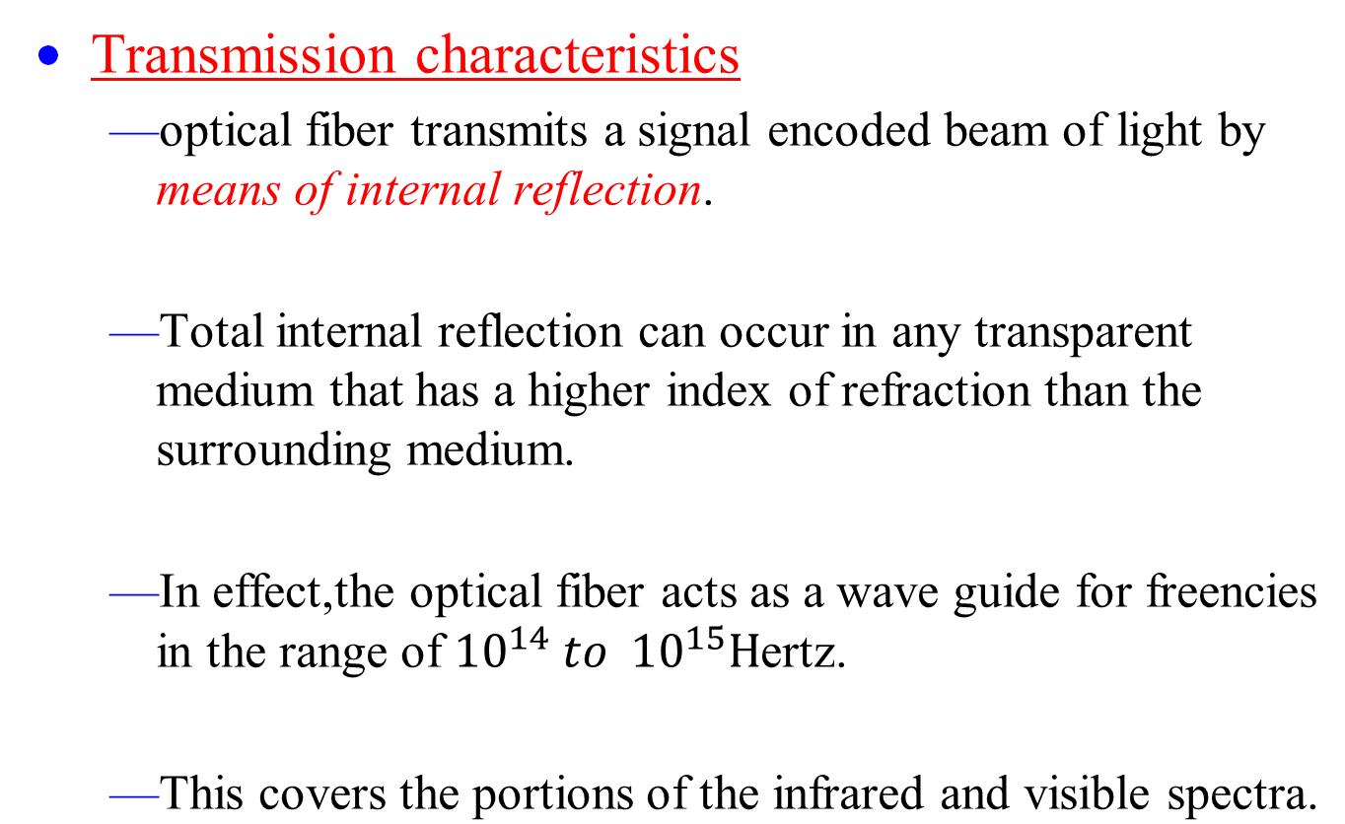
Optical Fiber

Slide 37
Optical Fiber Transmission modes
Three transmission modes
  Step-index mode
  Single-mode
  Graded index multimode

Slide 38
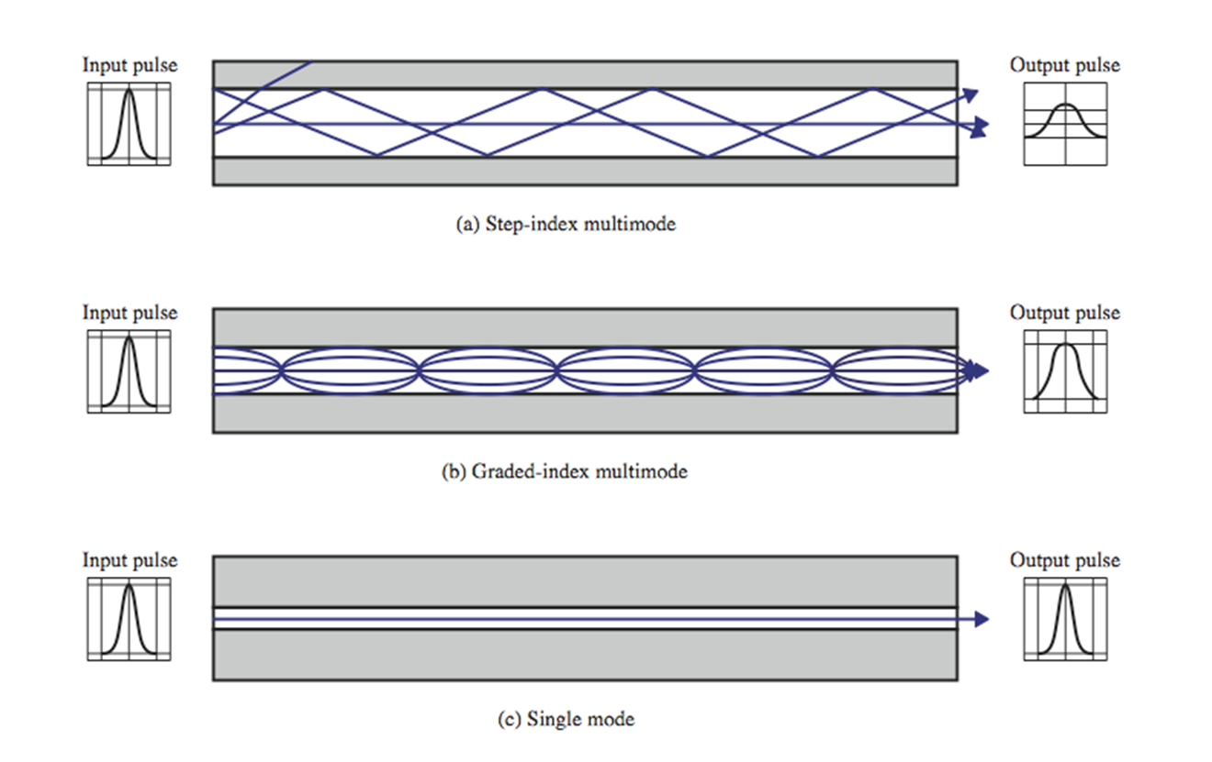
Optical Fiber Transmission modes

Slide 39
Optical Fiber Transmission modes
  Light from a source enters the cylindrical glass or plastic core.
  Rays at shallow angles are reflected and propagated along the fiber, other rays are absorbed by the surrounding material.
  This form of propagation is called step-index multi-mode, referring to the variety of angles that will reflect.

Slide 40
Optical Fiber Transmission modes
  With multimode transmission ,multiple propagation path exist, each with a different path length and hence time to traverse the fiber.
  This causes signal elements (light pulses)to spread out in time ,which limits the rate at which data can be accurately received .
  i.e. the need to leave spacing between the pulses limits the data rate.
  This type of fiber is best suited for transmission over short distances.

Slide 41
Optical Fiber Transmission modes
Single-mode
  When the fiber core radius is reduced ,fewer angles will reflect.
  By reducing the radius of the core to the order of a wavelength, only a single angle or mode can pass :the axial ray.
  Single mode propagation provides superior performance

Slide 42
Optical Fiber Transmission modes
Because there is a single transmission path with single-mode transmission ,the distortion found in multimode cannot occur.
Single-mode is typically used for long-distance applications ,including telephone and cable television.

Slide 43
Optical Fiber Transmission modes
Graded-index multimode
  Is achieved by varying the index of refraction of the core.
  This type is an intermediate between single-mode and step-index multimode in characteristics.
  The higher refractive index at the center makes the light rays moving down the axis advance more slowly than those near the cladding.

Slide 44
Optical Fiber Transmission modes
  Rather than zig-zagging off the cladding ,light in the core curves helically because the graded index, reducing its travel distance.
  The shortened path and higher speed allows light at the periphery to arrive at a receiver at about the same time as the straight rays in the core axis.
  Graded –index fibers are used in local area networks.

Slide 45
Optical Fiber
Two different types of light sources are used in fiber optic systems:
  The light emitting diode(LED)
  The injection laser diode(ILD)
Both are semiconductor devices that emit a beam of light when a voltage is applied.
The LED is less costly, operates over a greater temperature range and has a longer operational life,used for short distance(multimode).
The ILD ,which operates on the laser principle is more efficient and can sustain greater data rates(single mode)

Slide 46
Frequency Utilization for Fiber Applications
Wavelength (in vacuum) range (nm)
Frequency range (THz)
Band label
Fiber type
Application
820 to 900
366 to 333
Multimode
LAN
1280 to 1350
234 to 222
S
Single mode
Various
1528 to 1561
196 to 192
C
Single mode
WDM
1561 to 1620
185 to 192
L
Single mode
WDM

Slide 47
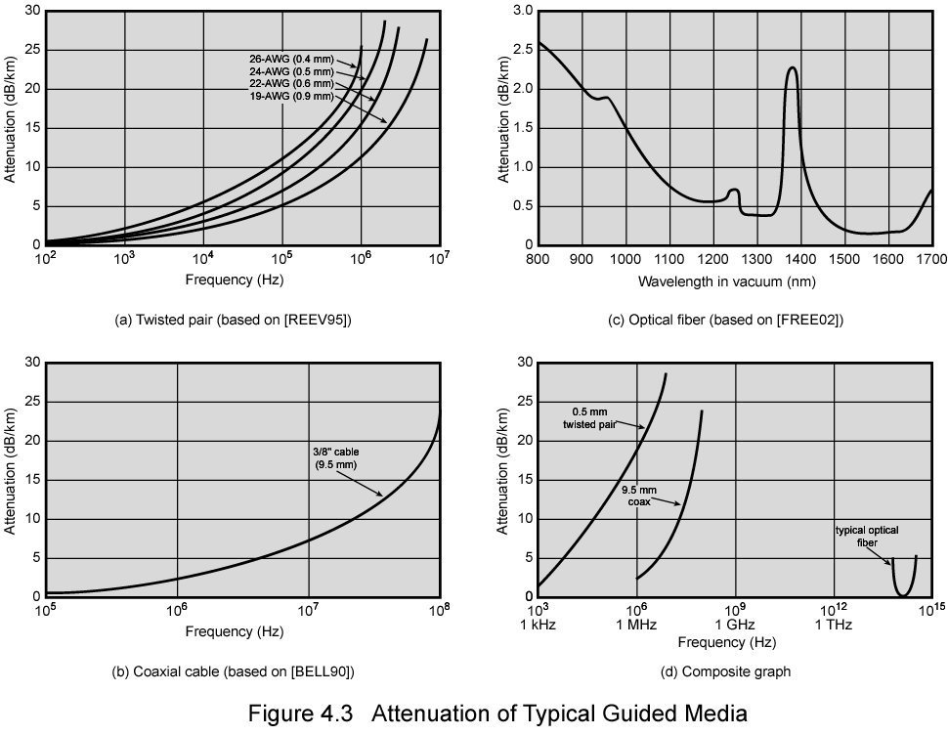
Attenuation in Guided Media

